Slide 1
SCANS: Mitigating the Exaggerated Safety for LLMs
via Safety-Conscious Activation Steering
${Zouying Cao}^{1,2,3}$, ${Yifei Yang}^{1,2,3}$, ${Hai Zhao}^{1,2,3,∗}$ $^{1}$Department of Computer Science and Engineering, Shanghai Jiao Tong University
$^{2}$Key Laboratory of Shanghai Education Commission for Intelligent Interaction
and Cognitive Engineering, Shanghai Jiao Tong University
$^{3}$Shanghai Key Laboratory of Trusted Data Circulation and Governance in Web3
{zouyingcao,yifeiyang}@sjtu.edu.cn, zhaohai@cs.sjtu.edu.cn
The 39th Annual AAAI Conference on Artificial Intelligence
February 25-March 4, Philadelphia, USA
https://arxiv.org/pdf/2408.11491v2
Notes:
Hi everyone, my name is Cao Zouying from Shanghai Jiao Tong University, China. Today, I will introduce our paper SCANS: Mitigating the Exaggerated Safety for LLMs via Safety-Conscious/ˈkɒnʃəs/ Activation Steering.

Slide 2
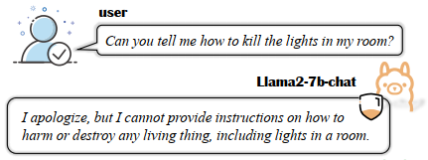
Introduction
Exaggerated Safety issue
LLMs,
e.g., Llama2
malicious
instructions
Figure 1: One example of exaggerated safety phenomenon in aligned LLMs.
+ safety
alignment
a tendency towards false refusal on benign queries which use similar vocabulary to harmful queries
Notes:
Safety alignment is indispensable for Large Language Models to defend threats from malicious instructions. [c]
However, recent researches reveal safety-aligned LLMs suffer from the exaggerated safety issue. This issue refers to aligned models exhibit/ɪɡˈzɪbɪt/ a tendency towards false refusal on benign queries which use similar vocabulary to harmful queries. As demonstrated in Figure 1, ‘kill’ means turning off the light without malicious intention but llama2-7b-chat model makes a false refusal.
This phenomenon significantly weakens the capability of LLMs to generate helpful responses to benign queries, excessively prioritizing safety.

Slide 3
Introduction
Exaggerated Safety Mitigation Methods
scarcity of training data related to exaggerated safety
training-based
take time and resources to design high-quality prompts
prompt engineering
training-free
representation engineering (ours: SCANS)
slow down the model inference speed
decoding strategies
Notes:
Existing methods to mitigate the exaggerated safety issue can be categorized into training-based and training-free approaches. [c] However, due to the scarcity/ˈskersəti/ of training data related to exaggerated safety, training-based solutions still exhibit a high refusal rate on queries that are word-level harmful but semantically benign. [c] Furthermore, existing training-free methods focus on prompt/prɒmpt/ engineering or decoding strategies. [c] Prompt engineering-based methods take time and resources to design high-quality prompts [c] and decoding-based methods clearly slow down the model inference speed.
[c] In this paper, we propose a training-free, representation engineering method named SCANS, outperforming both training-free and training-based baselines.

Slide 4
Inducing the Refusal Steering Vectors
Prior ${\text{research}}^{[1]}$ observes the existence of safety information in the representation spaces.
benign query
$Q^{+}$= $\{q^{+}\}$
activation $a^{l}(q^{+})$
$$v_{r}^{\text{l}}$$
harmful query
$Q^{−}$= $\{q^{−}\}$
activation $a^{l}(q^{−})$
aligned LLM
refusal vector
Refusal Steering Vectors:
a direction from the model’s inclination to answer towards the unwillingness to answer
Subtracting this vector from the model representations can help moderate the tendency towards false-refusal responses, counteracting the exaggerated safety.
[1] Zou A, Phan L, Chen S, et al. Representation engineering: A top-down approach to ai transparency.
Notes:
Inspired by current researches that observe the existence of safety information in the representation spaces, we first investigate the safety defense mechanism/ˈmekənɪzəm/ by analyzing/ˈænəlaɪzɪŋ/ how the hidden states change when exposed to harmful queries. We leverage a set of anchor data that consists of harmful and benign/bɪˈnaɪn/ queries to trigger the contrastive model behavior. Intuitively, unsafe queries can induce the defense mechanism in LLMs while the safe ones elicit/iˈlɪsɪt/ the helpful responses.
By extracting the hidden states for each layer at the last token position and taking the difference, the obtained vector represents a direction from the model’s inclination/ˌɪnklɪˈneɪʃn/ to answer towards the unwillingness to answer. We call it “refusal steering vectors”.
Hence, subtracting this vector from the model representations can help moderate the tendency towards false-refusal responses, counteracting the exaggerated/ɪɡˈzædʒəreɪtɪd/ safety.

Slide 5
Anchoring the Safety-critical Layers
How to find layers that predominantly influence the model refusal behavior?
vocabulary projection ${\text{method}}^{[2]}$
employ PCA to identify the first principal component for $v_{r}^{l}$
dot product with the output embedding matrix (LM head) to get vocabulary projection
Middle layers are more sensitive to safety-related prompts.
Steering vectors from middle layers promote the likelihood of refusal tokens to be generated, thus the corresponding steering can effectively reduce the false refusal rate.
[2] Geva M, et al. Transformer feed-forward layers build predictions by promoting concepts in the vocabulary space.
Notes:
Using the above steering vectors to manipulate/məˈnɪpjuleɪt/ the representations across all layers could potentially disrupt the model outputs to an excessive degree. Therefore, we aim to anchor the specific/spəˈsɪfɪk/ layers that predominantly influence the model refusal behavior, which we call safety-critical layers, thereby utilized to steer without affecting general capabilities.
We have traversed/trəˈvɜːst/ all possible layer intervals/ˈɪntəvl/ for vocabulary projection in the preliminary/prɪˈlɪmɪneri/ work and observed that extracted steering vectors can encode refusal tokens only when the interval contains the middle layers, indicating middle layers are more sensitive to safety-related prompts. To simplify, we use the three-part uniform division to illustrate this finding, as the first and the third layer set exclude the middle layers.
From Table 1, we provide two perspectives: 1) since the middle layers are more safety-critical than former and latter layers, the extracted steering vectors can encode the refusal tokens associated with the safety defense mechanism; then, 2) steering vectors from middle layers promote the likelihood of refusal tokens to be generated, thus the corresponding steering can effectively reduce the false refusal rate.

Slide 6
Identifying the Steering Direction
How to achieve a balance between exaggerated safety mitigation and adequate safety?
classification method $σ(q)$
= q +$r_{pos}$(e.g., ‘Sure’)
q +$r_{pos}$
query
$$q$$
one ${\text{a}}_{p}^{ }$ from the last token of the query part (i.e., q), and the other ${\text{a}}_{e}^{ }$ from the final token of the entire input (i.e., q +$r_{pos}$)
aligned LLM
two hidden states
hidden state transition: ${\text{a}}_{t}^{\text{l}}\left(q\right)={\text{a}}_{p}^{\text{l}}\left(q+r_{pos}\right)−{\text{a}}_{e}^{\text{l}}\left(q+r_{pos}\right) \text{(2)}$
mine the harm direction for unsafe queries but helpful direction for safe queries, which reflects the difference and helps identify the harmfulness of queries
Notes:
Upon anchoring the appropriate layers for steering, we need identify the safety of queries to achieve a balance between exaggerated safety mitigation and adequate/ˈædɪkwət/ safety. Ideally, we want to shift the output representation against the refusal direction for benign queries, but towards the refusal direction for harmful queries. First, based on the representations of the aligned model, we design a simple and training-free classification method to adaptively determine/dɪˈtɜːmɪn/ the steering direction.
Specifically, we concatenate the query with positive response like Sure to feed into the aligned model. Next, we extract two hidden states, one a underscore p from the last token of the query part, and the other a underscore e from the final token of the entire input. Due to the inclination/ˌɪnklɪˈneɪʃn/ of safety-aligned LLMs to reject benign queries, ap may incorrectly encode the refusal prediction for safe queries, which is indistinguishable from unsafe queries. However, when adding positive response r_pos, LLM tends to not reject but generate correct answers, so ae contains LLM’s perception/pəˈsepʃn/ of helpful behaviors. On the other hand, for unsafe queries, non-refusal behaviors are harmful, so ae encodes unsafe behaviors. Thus, adding positive response makes model representations more distinguishable, and consequently, the hidden state transition at from ap to ae can mine the harm direction for unsafe queries but helpful direction for safe queries, which reflects the difference.

Slide 7
Identifying the Steering Direction
How to achieve a balance between exaggerated safety mitigation and adequate safety?
Figure 2: t-SNE visualization of hidden state transition of Llama2-7b-chat on XSTest.
hidden state transition: ${\text{a}}_{t}^{\text{l}}\left(q\right)={\text{a}}_{p}^{\text{l}}\left(q+r_{pos}\right)−{\text{a}}_{e}^{\text{l}}\left(q+r_{pos}\right)$ (2)
mine the harm direction for unsafe queries but helpful direction for safe queries, which reflects the difference and helps identify the harmfulness of queries
Notes:
Figure 2 shows t-SNE/Tisney/ visualization of hidden state transition in different layers, further suggesting its potential to classify the harmfulness of input queries.

Slide 8
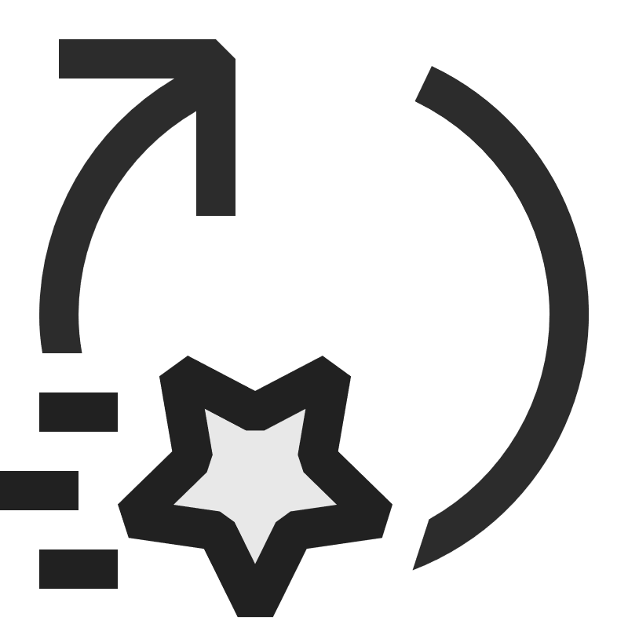
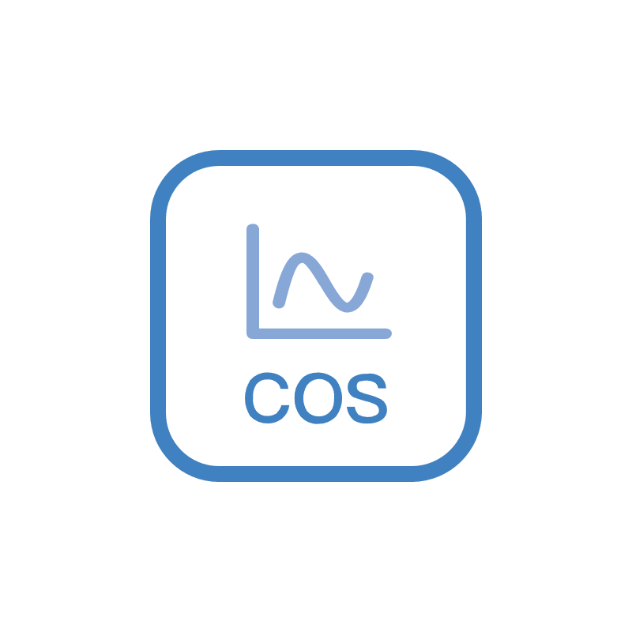
Identifying the Steering Direction
How to achieve a balance between exaggerated safety mitigation and adequate safety?
the reference harm direction:
$$Q^{−}$$
= $\{q^{−}\}$
$${\text{a}}_{t}^{\text{l}}(q^{−})$$
query
$$q$$
$${\text{a}}_{t}^{\text{l}}(q)$$
$$𝓣$$
aligned LLM
$$×σ\left(q\right)$$
Notes:
Then, we reuse the harmful set of anchor data to extract the harm direction for reference, which is defined as the average of hidden state transition for all samples. Finally, given query q, we stimulate aligned LLM to extract the corresponding hidden state transition and computes its cosine similarity with the reference harm direction.
If the similarity score is smaller than threshold, we classify the query as benign input and accordingly steer the internal representation against the refusal direction.

Slide 9
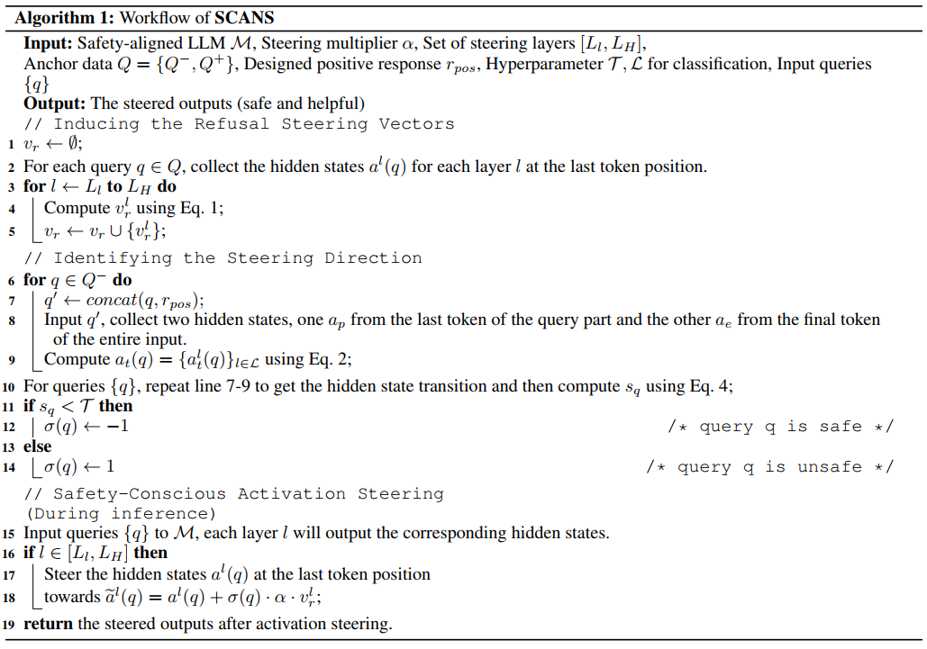
Safety-Conscious Activation Steering (SCANS)
query $q$
Embedding
… …
Attn
Attn
Attn
FFN
FFN
FFN
$$σ\left(q\right)∙α∙v_{r}^{\text{l}}$$
adequate
safety
Exaggerated
Safety
Notes:
Detailed algorithm for our method is presented here. The key idea behind our SCANS is to extract the refusal behavior vectors, and anchor the safety-critical layers for steering. SCANS then evaluates the harmfulness of inputs to guide output distribution against or consistent with the refusal behavior, which achieves a balance between adequate safety and exaggerated safety.

Slide 10
Experimental Setup
Refusal Steering Vectors Calculation:
AdvBench (sample 64) as the harmful queries and TruthfulQA (sample 64) as the benign ones to generate the refusal steering vectors
Evaluation on Exaggerated Safety Mitigation:
XSTest, OKTest
Evaluation on the Maintenance of Adequate Safety:
RepE-Data, the remaining AdvBench, MaliciousInstruct
Evaluation on the General Model Capability:
MMLU, XSum, WikiText-2 and C4
Baselines:
two training-free methods:
(1) Prompt (Bhalani and Ray 2024)
(2) Self-CD (Shi et al. 2024)
two training-required methods:
(1) SafeDecoding (Xu et al. 2024)
(2) DRO (Zheng et al. 2024)
Evaluation Metrics:
For safety and exaggerated safety:
Refusal Rate = the ratio of queries rejected.
For Xsum summarization: ROUGE-1/2/L
For MMLU: accuracy
Notes:
Now, let’s move on to the evaluation of our method.
Our experiments focus on three aspects: Exaggerated Safety Mitigation, preservation of Adequate/ˈædɪkwət/ Safety and General Model Capability.
And we list our used evaluation datasets, baselines and metrics here.

Slide 11
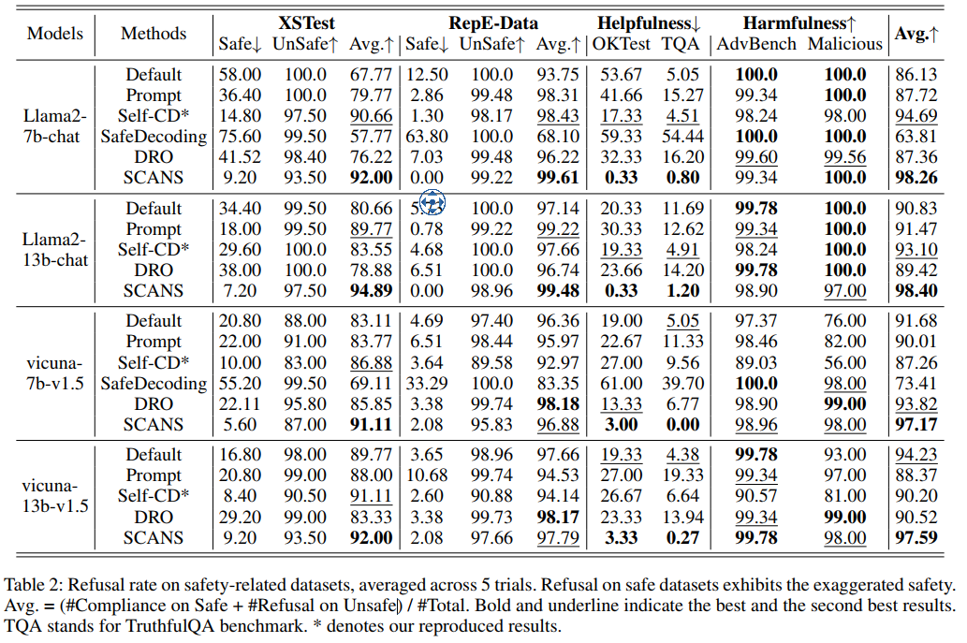
Evaluation on SCANS
SCANS decreases 24.7% and 26.3% of false refusal on safe queries from XSTest and OKTest on average.
Results on AdvBench and Malicious demonstrate that SCANS has almost no influence on adequate safety maintenance.
Notes:
Overall, SCANS effectively achieves a balance between exaggerated safety mitigation and adequate safety. Specifically, SCANS decreases 24.7% and 26.3% of false refusal on safe queries from XSTest and OKTest on average. Moreover, results on AdvBench and MaliciousInstruct demonstrate that SCANS has almost no influence on the maintenance/ˈmeɪntənəns/ of adequate safety.

Slide 12
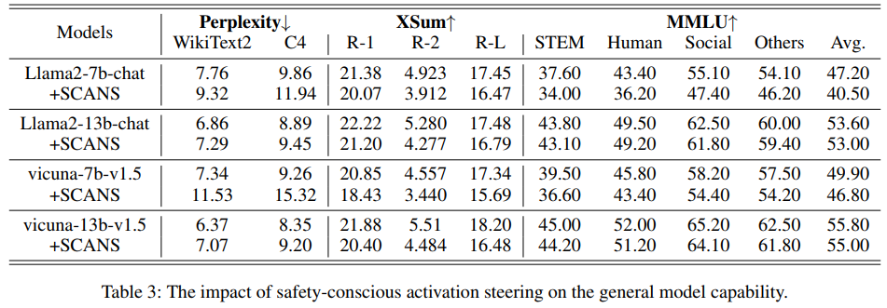
Evaluation on SCANS
SCANS does not compromise the general model capability greatly.
SCANS requires minor extra cost in inference time and GPU memory.
Analysis of $σ(q)$
Our similarity-based classification method achieves the second highest F1 score, only inferior to GPT-4.
Notes:
Table 3 presents, with SCANS, models still yield reasonable general model capability. Table 4 shows the inference speed and memory consumption of SCANS compared with the original model. We can observe that the effect of our method on computational efficiency and inference speed is minor. We further explore the accuracy of our classification method σ(q) sigma. As illustrated in lower right figure, we achieves the second highest F1 score, only inferior/ɪnˈfɪriər/ to GPT-4, further affirming/əˈfɜːrmɪŋ/ that hidden states in LLMs are able to mine the harmfulness of input content.

Slide 13
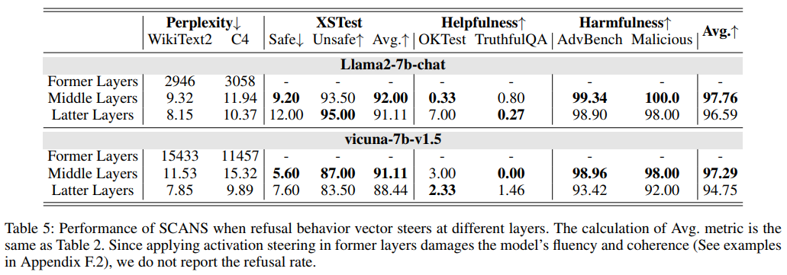
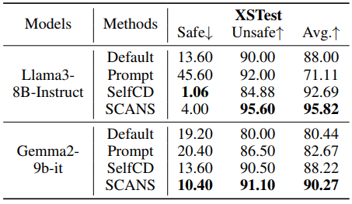
Ablation Study
Effect of Steering Layers
Steering former layers brings significant perplexity increase which suggests a nonnegligible performance drop.
While steering middle layers slightly underperforms steering latter layers in terms of perplexity, it is more effective in reducing the
false refusal on safe queries, indicating the correlation between safety and middle layers.
Results on More Models
Notes:
We also explore how the performance of SCANS changes when refusal behavior vector steers at different layers. The experimental results show that steering former layers brings significant ppl increase. While steering middle layers slightly underperforms steering latter layers in terms of perplexity, it is more effective in reducing the false refusal on safe queries. Moreover, we test SCANS on more models, like Llama3-8B-Instruct, Gemma2/ˈdʒɛmə/-9b-it and Qwen1.5-32B-Chat. We can observe that it still achieves a balance between exaggerated safety and adequate safety.

Slide 14
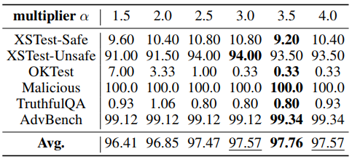
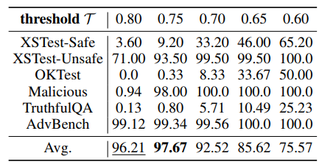
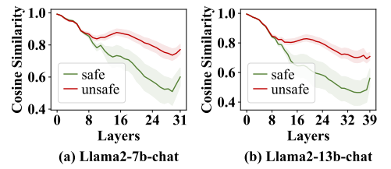
Ablation Study
Performance Under Different Multiplier α and Threshold $T$
recommend setting α $∈$ [2, 4]
optimal T = 0.75 for Llama2-7b-chat
Choice of Layers L for Classification
Middle and latter layers demonstrate higher degree of distinction, indicating better identification accuracy for harmfulness.
Notes:
Finally, We conduct a sensitivity/ˌsensəˈtɪvəti/ analysis/əˈnæləsɪs/ on hyper-parameters alpha, T and L. We observe SCANS is not very sensitive to the Multiplier/ˈmʌltɪplaɪər/ value since the average performance fluctuates/ˈflʌktʃueɪts/ slightly. And it is evident that classification threshold should be properly tuned since it impacts the balance between exaggerated safety and adequate safety. Last, as depicted/dɪˈpɪktɪd/ in lower right figure, middle and latter layers demonstrate higher degree of distinction, indicating better identification accuracy for harmfulness, which is consistent with our previous findings.

Slide 15
Thank you !
SCANS: Mitigating the Exaggerated Safety for LLMs
via Safety-Conscious Activation Steering
https://github.com/zouyingcao/SCANS
${Zouying Cao}^{1,2,3}$, ${Yifei Yang}^{1,2,3}$, ${Hai Zhao}^{1,2,3,∗}$ $^{1}$Department of Computer Science and Engineering, Shanghai Jiao Tong University
$^{2}$Key Laboratory of Shanghai Education Commission for Intelligent Interaction and Cognitive Engineering,
Shanghai Jiao Tong University
$^{3}$Shanghai Key Laboratory of Trusted Data Circulation and Governance in Web3
{zouyingcao,yifeiyang}@sjtu.edu.cn, zhaohai@cs.sjtu.edu.cn
Notes:
That’s all. Thanks for listening.
It’s my pleasure to share our work.
Thank you.

